Slide 1

RESTful API #2
Praktikum #4
Review Soal UTS

Slide 2
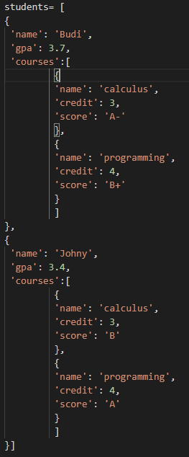
Struktur Data
Buka file mhs.py
Perhatikan dan pahami struktur datanya (dalam json)
Perhatikan:
“students” adalah list yang berisi data “student”
Setiap “student” memiliki “name”, “gpa”, dan sebuah list “courses”
List “courses” berisi “course”, yaitu daftar mata kuliah yang diambil
students
student
student
name
name
gpa
courses
course
course
gpa
Budi
3.7
name
Calculus
credit
3
score
A-
name
Programming
credit
4
score
B+
Johny
3
courses
course
name
calculus
credit
3
score
B
course
name
programming
credit
4
score
A

Slide 3
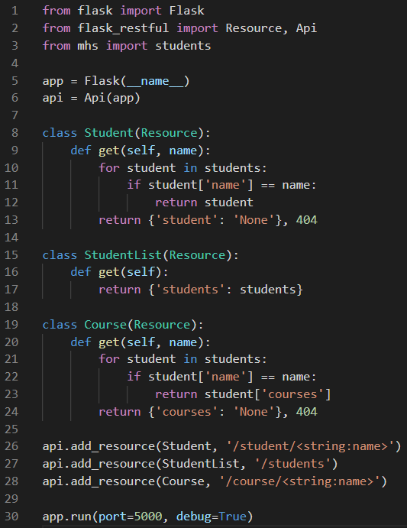
Jawaban Soal UTS
Perhatikan logika perulangan untuk setiap class dan end-point pasangannya.
Class
1. class Student(Resource):
def get(self, name):
for student in students:
if student['name'] == name:
return student
return {'student': 'None'}, 404
2. class StudentList(Resource):
def get(self):
return {'students': students}
3. class Course(Resource):
def get(self, name):
for student in students:
if student['name'] == name:
return student['courses']
return {'courses': 'None'}, 404
End-Point
api.add_resource(Student, '/student/<string:name>')
api.add_resource(StudentList, '/students')
api.add_resource(Course, '/course/<string:name>')

